Slide 1

AI-Powered Accounting for Africa
AI-driven Accounting & Tax Automation
SYSCOHADA · Senegal & OHADA Zone (17 countries)
GITEX AFRICA 2026 · Marrakech
www.korametrics.com

Slide 2




The Problem
80% of African accountants' time
is spent on manual data entry
Massive manual entry
Costly tax errors
Hundreds of invoices processed by hand every month
Tax penalties, permanent non-compliance risks
Impossible to scale
Inadequate tools
Growth capped by manually processable volume
Sage, Cegid, Excel: no local tax automation

Slide 3



The Kora Metrics Solution
Humans always decide. AI proposes, the professional validates.
01
02
03
Digitization & Extraction
AI Tax Analysis
Ready-made Declarations
→
→
Upload invoices (PDF, scans, photos).
AI automatically extracts all data.
SYSCOHADA allocation, tax identification,
real-time anomaly detection.
Auto-generate VAT, CIT, withholdings.
Professional validates and submits.

Slide 4



Why Now?
Tax Digitalization
Senegal accelerating electronic tax declarations
AI Revolution
LLMs finally enable document analysis at scale
New Generation
Digital-native accountants seeking modern tools
Competitive Void
Zero competitors on OCR → SYSCOHADA → Local declarations chain

Slide 5
Traction & Proof
70-80%
4
3
17
time savings
proven on MVP
functional
AI modules
committed
accounting firms
addressable
OHADA countries
MVP finalized — Beta test with SENCAS (Dakar) starting April 2026
2 additional firms committed in Benin and Ivory Coast
Modules: OCR+Tax, Bank reconciliation, VAT, Payroll

Slide 6
Business Model
B2B SaaS Subscription · Recurring Revenue
Starter
Pro
Enterprise
25,000 XOF/mo
75,000 XOF/mo
180,000+ XOF/mo
~€38
~€114
~€274
Small firms
1-3 employees
Structured firms
Advanced modules
Large firms
Customization + API

Slide 7
Market & Opportunity
TAM
17 OHADA countries
Tens of thousands of firms & SMEs
SAM
Senegal
300+ accounting firms
SOM
50 clients · Year 1
150 clients · Year 3
Note : 1 accounting firm manages minimum 10 companies. We bill per company

Slide 8
Competition & Differentiation
Excel/Manual
Sage
Cegid
Kora Metrics
Invoice OCR
✗
✗
✗
✓
SYSCOHADA Analysis
✗
✗
✗
✓
Local Tax Declarations
✗
✗
✗
✓
Native AI
✗
✗
✗
✓
Multi-country OHADA
✗
✗
✗
✓
Africa-adapted Pricing
✗
✗
✗
✓

Slide 9
Go-to-Market
Phase 1 · M1-3
Phase 2 · M4-6
Phase 3 · M7-12
Direct sales
& validation
Scale
acquisition
Growth
& expansion
→
→
1-3 paying clients
SENCAS beta test
10-15 clients
Client testimonials
50+ clients
3 OHADA countries
Acquisition Channels
WhatsApp (zero cost)
LinkedIn thought leadership
Institutional partnerships (OEC, ADEPME)
Video content & demos

Slide 10
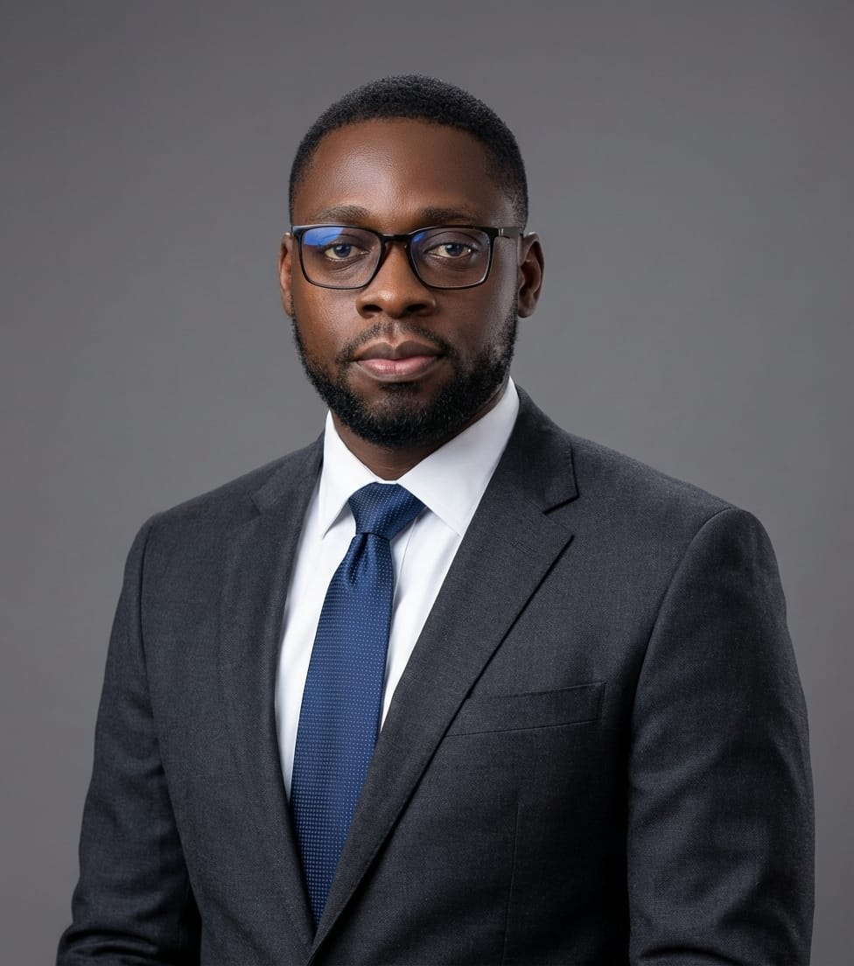
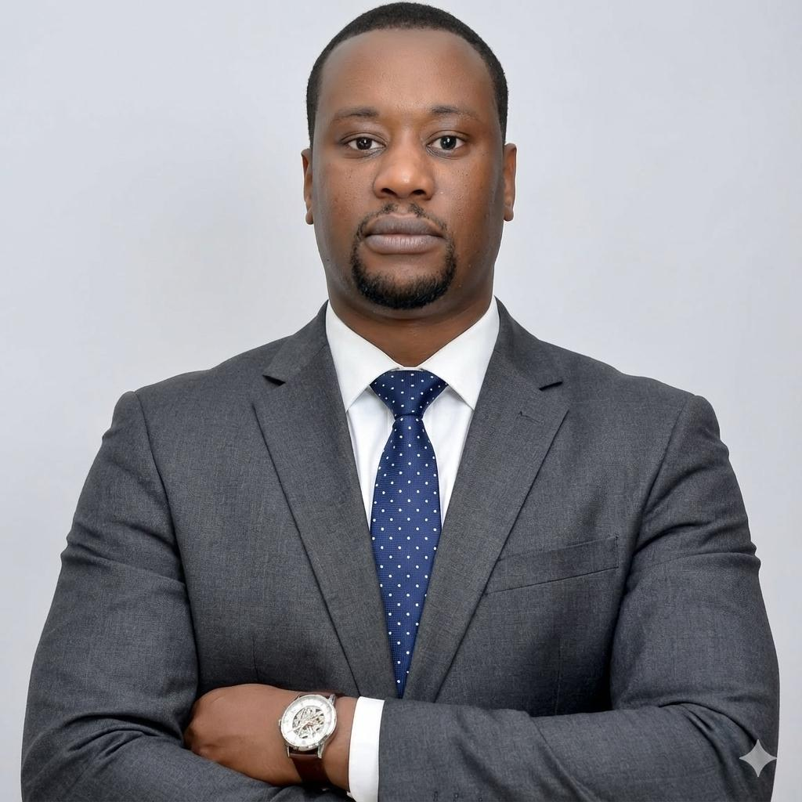
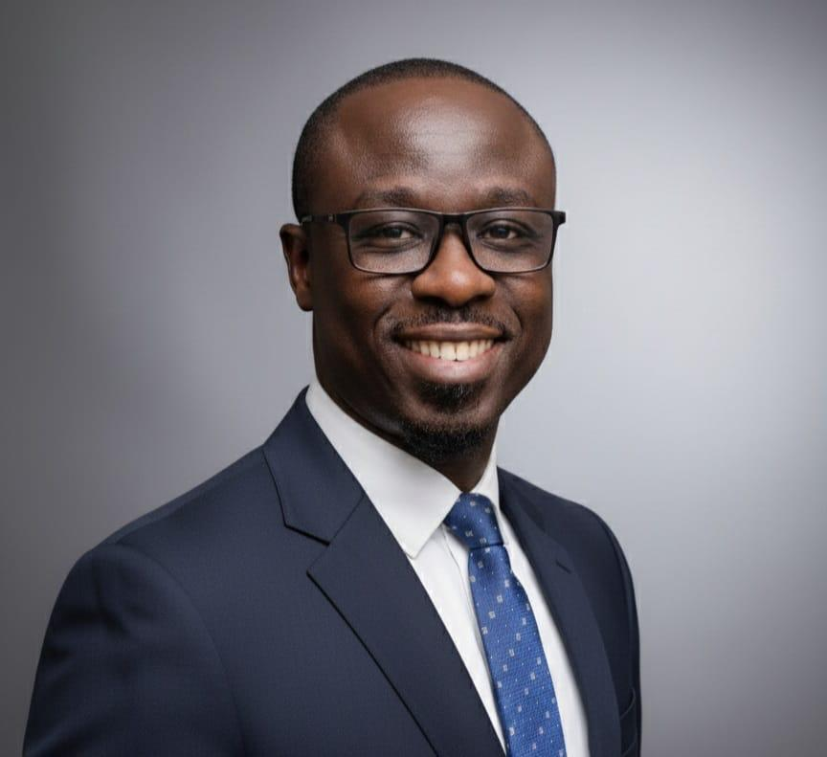
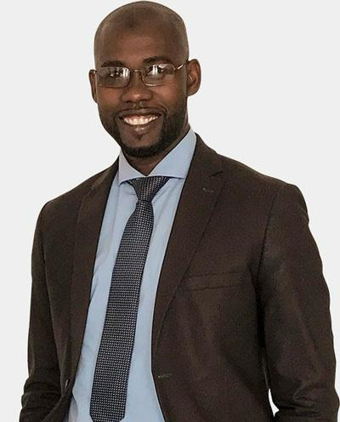
The Team
66 years combined experience · Finance, Tax, Technology & Law
Sédar H. Senghor
Medoune Ndiaye
Cheikh A.T. Diouf
Alassane Boye
CEO
CTO
Tax Director
Operations Dir.
16y · Finance, Strategy,
Accounting & Tax
École de Guerre Économique Paris
15y · Solutions Architecture
& AI · Ex-Microsoft
ERP deployments Africa & ME
15y · Tax law specialist
Former firm tax director
Tax automation expert
20y · Business law, Tax
Consulting & Management
Legal & tax firm leadership

Slide 11
Roadmap & Funding
Key Milestones
Pre-seed Raise
300 000 €
2-year runway
H1 2026
Beta test · First 15 paying clients
Salaries (3 co-founders + hires)
€238,000
79%
H2 2026
Infrastructure & Cloud
€39,000
13%
50 clients · Expand to Benin & Ivory Coast
Marketing & Sales
€27,000
9%
2027
100+ clients · 3 countries · Full ERP integration

Slide 12



Join the African accounting revolution
contact@korametrics.com
+221 77 182 39 26 (Sédar)
+221 78 137 91 90 (Medoune)
www.korametrics.com
GITEX AFRICA 2026 · Marrakech · April 7-9

